Slide 1
Online food ordering system
Whatever you want, wherever you want

Slide 2
02
01
03
04
Abstract, Vision
Prototype, testing, further updates
Requirements, Sprint planning
Uml and Sprint diagrams
We will discuss the abstract and vision behind our project
We will explain how the website works and if there are any updates we will discuss them
We will discuss the expectations, requirements of this particular system here.
Views, flow of the system will be explained through these diagrams

Slide 3
Abstract
The online food order and delivery system has provided consumers with unprecedented convenience, allowing them to browse menus, choose from a variety of restaurants, and place orders from the comfort of their own homes. By aggregating supply from multiple restaurants onto a single platform, these aggregator businesses have simplified the process of browsing, choosing, and ordering food for consumers. They have also benefited the restaurant industry by providing them with a new channel for reaching customers and increasing their sales. Thus we prepared a system where you can order from your favorite restaurant from anywhere and you can get it delivered anywhere.

Slide 4
Product Vision
The objective of our food delivery system for restaurants is to optimize and elevate the dining experience for both customers and restaurant personnel. This application is designed to offer efficient order processing, seamless payment handling, and valuable data analytics. Our goal is to provide a convenient and delightful dining experience for customers, allowing them to savor restaurant-quality food
in the comfort of their homes, while ensuring that our restaurant partners can operate seamlessly and effectively in the delivery ecosystem.

Slide 5
Concept
Online food order delivery is a convenient service that enables customers to select and purchase meals from restaurants via the internet or mobile apps. This concept streamlines the entire process, allowing users to browse menus, place orders, and make payments online. Restaurants receive these orders digitally and prepare the requested food. Couriers then pick up the orders and deliver them to the customers' doorsteps, ensuring a seamless and efficient dining experience. This innovative model combines technology, logistics, and the culinary industry, offering a wide range of food choices and simplifying meal delivery, making it a popular choice for modern consumers.

Slide 6
Requirements
Developing an online food ordering and delivery system requires careful consideration of various types of requirements to ensure a seamless and efficient user experience. Here's a list of key requirements for such a system
1.Functional requirements
2.Non functional requirements.

Slide 7
Functional requirements
Functional requirements for a food ordering system can vary depending on the specific needs of the restaurant or food delivery service. It should include:
User Registration and Authentication:
User registration for customers, restaurant staff, and administrators.Secure authentication methods (e.g., username and password, two-factor authentication).
Menu Management:
Ability to add, edit, and remove menu items.Categorization of menu items (e.g., appetizers, main courses, desserts).Pricing and description for each menu item. Option to add images or descriptions for menu items.
Order Placement and Processing:
User-friendly interface for customers to browse and select items.Customization of orders (e.g., special requests, modifications).Real-time order tracking for customers.Integration with payment gateways for secure transactions.
MyDelivery

Slide 8
Functional requirements (continued)
Inventory Management:
Administrators should be able to track ingredient and supply quantities. Reorder alerts should be generated when inventory levels reach a specified minimum threshold.Staff should be able to update inventory quantities as ingredients are used or restocked.
Payment Processing:
Customers should be able to pay for their orders using various payment methods (credit/debit cards, cash, mobile wallets). Cashiers should have the ability to process
payments, apply discounts, and split bills if necessary. Digital receipts should be generated and sent to customers via email.
Order Confirmation and Notifications:
Confirmation messages to customers after order placement.Notification to restaurant staff with order details.SMS or email notifications for order status updates.

Slide 9
Functional requirements (Continued)
Delivery Tracking:
Assigning delivery drivers to orders.Real-time tracking of delivery status.Estimated delivery times for customers.
User Reviews and Ratings:
Option for customers to leave reviews and ratings.Display of reviews and ratings for menu items and restaurants.
User Profiles:
User profiles for customers to manage their information and preferences.Restaurant staff profiles with permissions and roles.
Admin Panel:
Dashboard for administrators to manage users, restaurants, and settings.Tools for content moderation and quality control.User activity logs and audit trails.
Support and Helpdesk:
Contact and support options for customers.Ticketing system for handling customer inquiries and issues.

Slide 10
Non Functional Requirements
User-friendly interface for easy navigation and use
High performance and scalability to handle large amounts of data placement, payment processing, and other interactions.
Respond quickly to user actions, with minimal delays during order
Compatibility with various operating systems and devices
Ability to handle multiple users and concurrent access to the system
Compliance with relevant laws and regulations regarding food ordering system and data privacy
Regular updates and maintenance to ensure the system remains functional and secure over time.

Slide 11
Timeline
Week 1
Week 2
Week 3
Week 4
Uml diagrams
Database connection
Designing of website
Frontend and backend connection

Slide 12
Sprint Planning
Sprint 1
Sprint 2
Sprint 3
Sprint 4
Setting Up the Foundation:
1.Develop user authentication and login system.
2.Create a basic database schema for storing customer information and orders.
Menu and Pricing
1.Design and implement a menu management system.
2.Allow administrators to add, edit, and delete menu items.
3.Associate prices and ingredients with each menu item.
Order Management
1.Customers should be able to view the menu, select items, quantities
and place orders.
2.Cashiers should be able to create, modify, and manage customer
orders.
Payment Processing
I1.ntegrate a payment gateway for processing customer payments.
2.Allow cashiers to apply discounts and manage payment options.
3.Implement receipt generation for customers.

Slide 13
Sprint Planning
Sprint 5
Sprint 6
Sprint 7
Sprint 8
Inventory Management
1.Enhance the inventory management system with reorder alerts.
2.Allow administrators to update ingredient quantities and suppliers.
Order Tracking Management
1.Customers Should be able to track their orders
2.Customers should be able to manage their order delivery
Review and Rating interface
1.Customer should be able to get in contact with the management of
ordering system through the interface.
2.There should be an interface for interacting and titled as ‘Contact us’
Final Polish and Testing
1.Conduct thorough testing of all system features.
2.Fine-tune user interfaces and resolve any remaining bugs.
3.Prepare for a full release of the ‘Food ordering system”.

Slide 14
Working of sprints
At the end of each sprint, hold a sprint review meeting to demonstrate the
completed features to stakeholders and gather feedback.
Discuss what went well, what could be improved, and decide whether the
completed features meet the acceptance criteria.
Based on the feedback and insights from the sprint review and retrospective,
adjust the product backlog, refine user stories, and reprioritize as necessary.
Plan the next sprint based on the updated backlog and repeat the cycle.

Slide 15
UML Diagrams
UML, short for Unified Modeling Language, is a standardized modeling language consisting of an integrated set of diagrams, developed to help system and software developers for specifying, visualizing, constructing, and documenting the artifacts of software systems, as well as for business modeling.

Slide 16
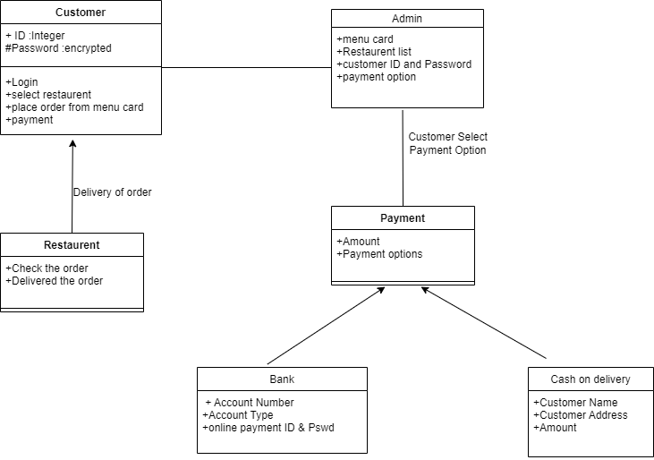
Class Diagram

Slide 17
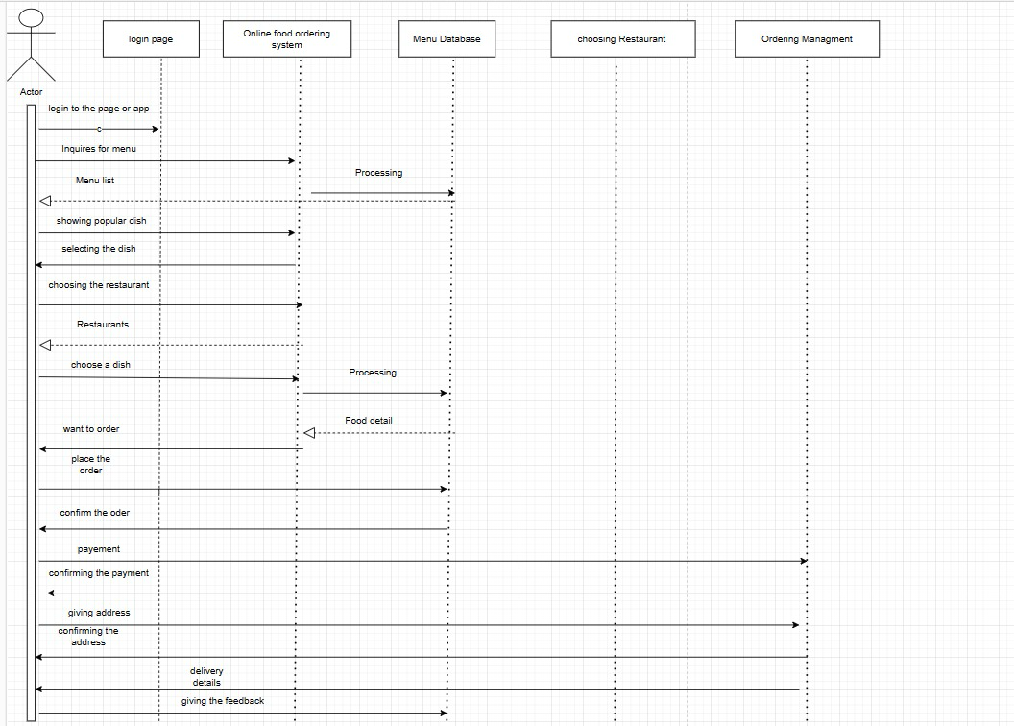
Sequence Diagram

Slide 18
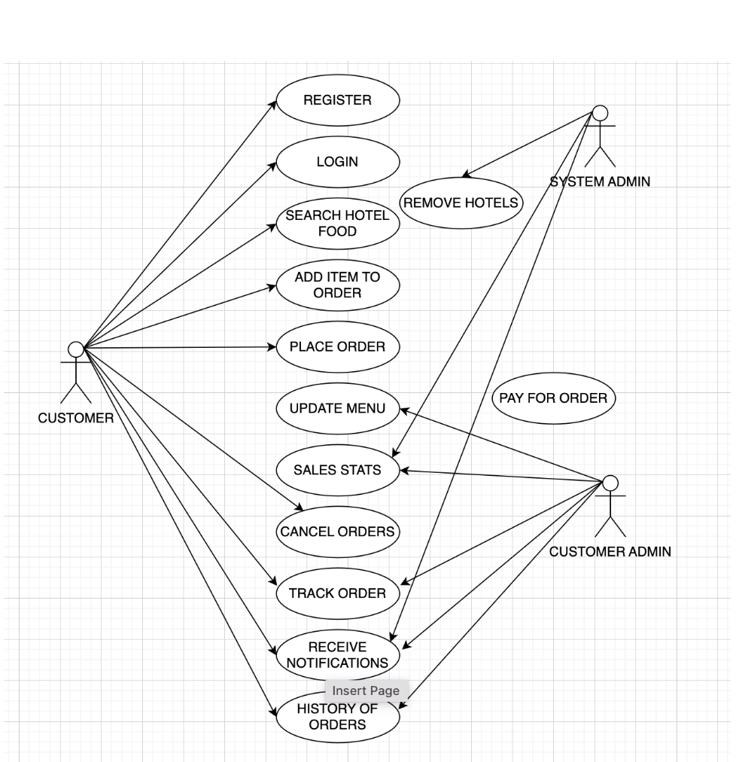
Use case Diagram

Slide 19
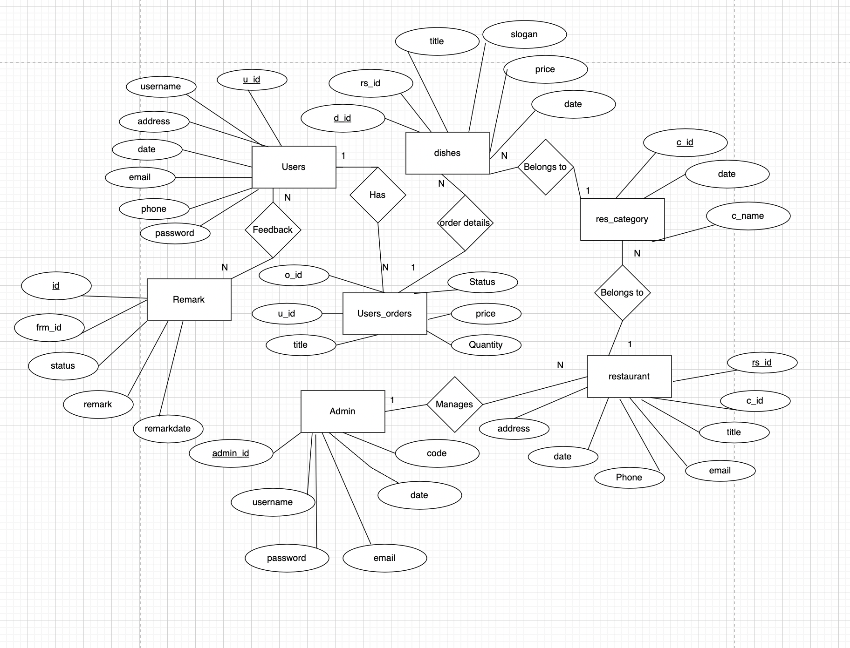
ER Diagram

Slide 20
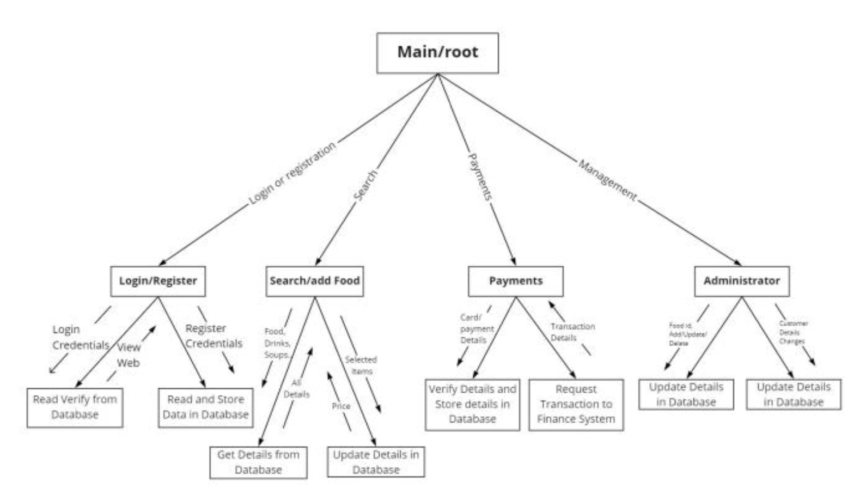
Structure chart Diagram

Slide 21
Let’s see how far we came in designing the system
We will explain you the working of pur website along with backend database here.

Slide 22
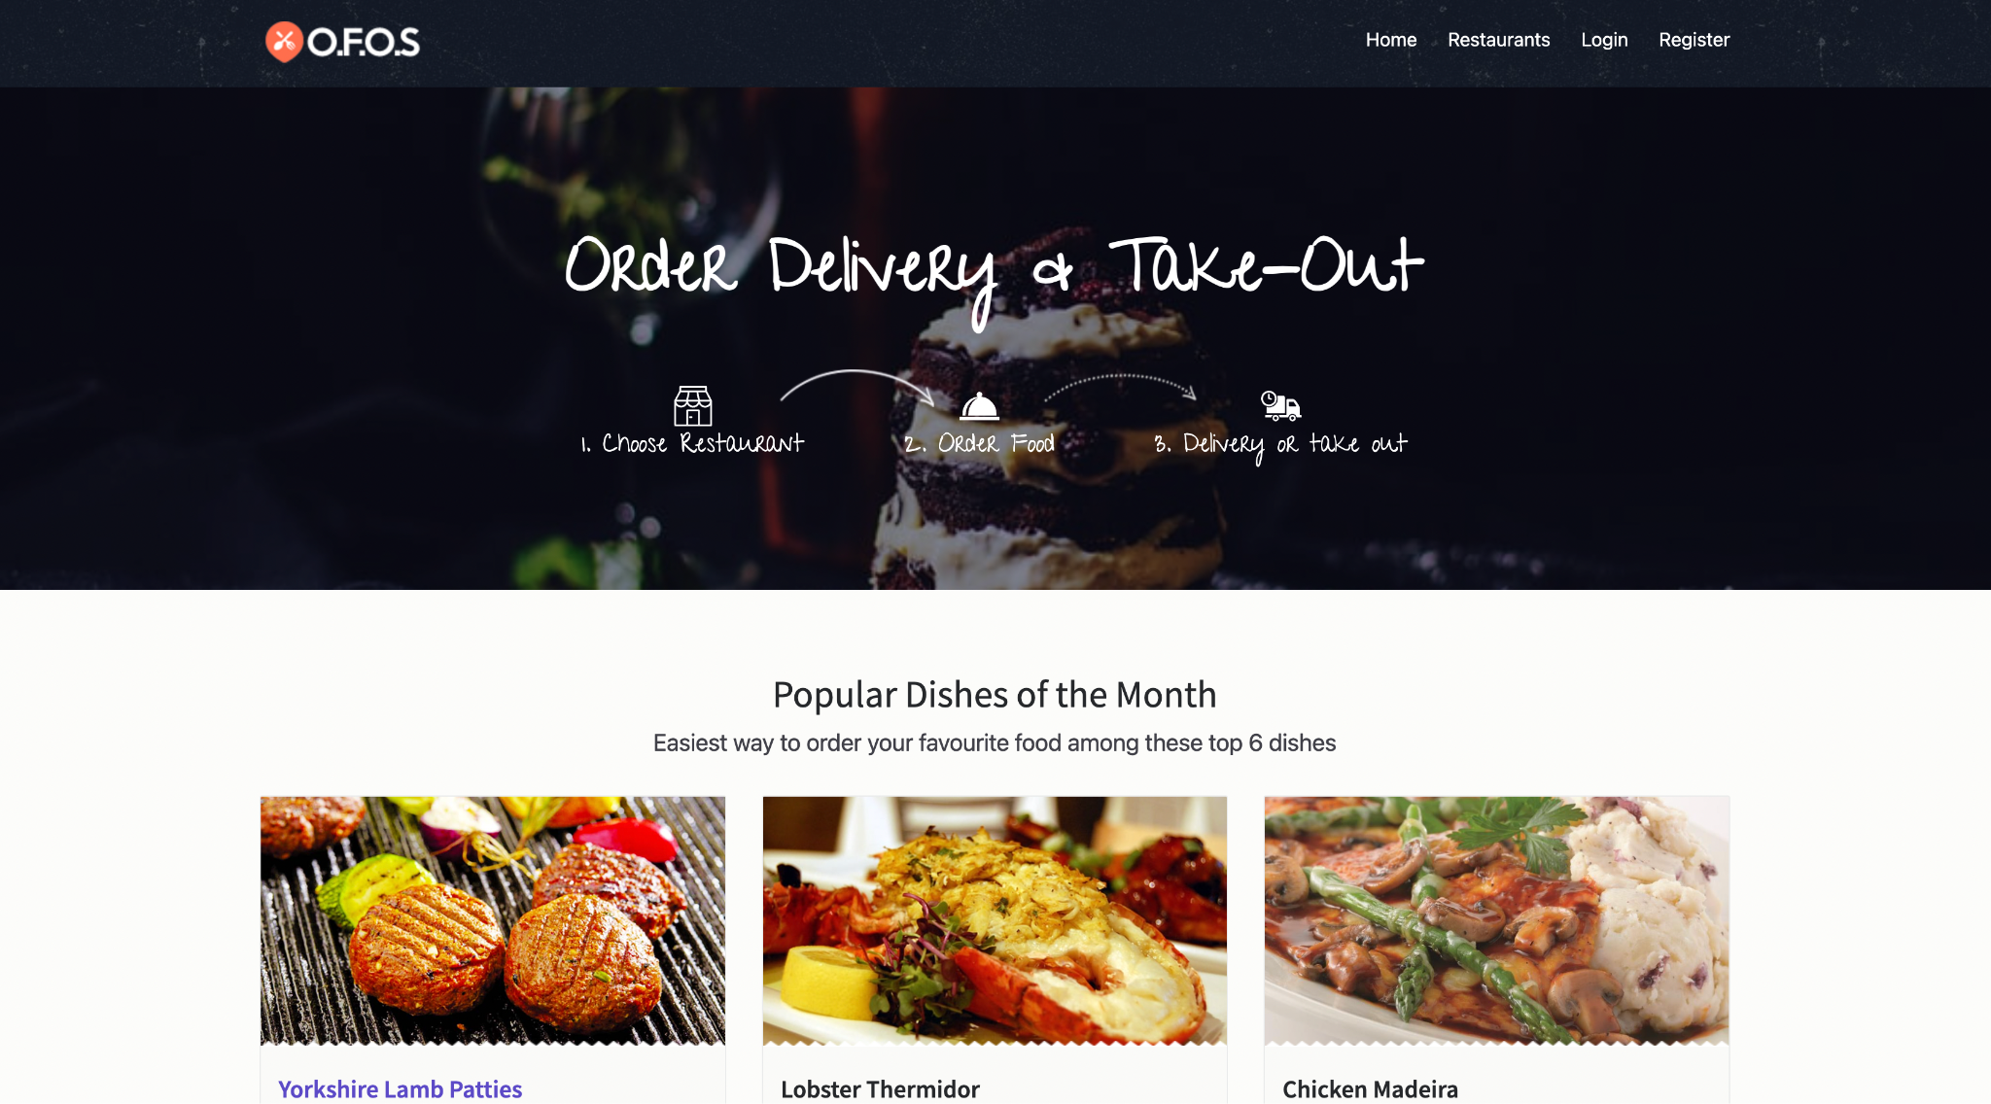
Website screenshot
S
Strengths
O
Opportunities
W
Weaknesses
T
Threats
Despite being red, Mars is actually a cold place
Neptune is the farthest planet from the Sun
Saturn is composed of hydrogen and helium
Venus is the second planet from the Sun

Slide 23
Product Demo
We will show you the product demo here

Slide 24
Testing
Database storing
Database connection
Flow of content
Mistakes
Check whether the backend and frontend has been connected or not
Check whether pre stored info is accepting or not
Check the flow of website and its functionaity
Purposely give wrong details and check whether it showing error or not

Slide 25
Further Updates
Create a dedicated login page for different roles allowing them to access their accounts securely.
Account confirmation Email
Implement an order tracking system th enables customers to monitor the status and progress of their orders in real-time, enhancing transparency and convenience
Include various contact methods for customers to reach out for inquiries or support.
Allow customers to leave reviews and ratings for their café experiences.\

Slide 26
Feedback
Delivery Person
Delivery person will deliver the order on time and safe mode
User
Based on the quality of food and delivery experience, customer can give the review

Slide 27
Team members
SINDHU GAYATHRI (20MIS7007)
GVMJ DEEPTHI(20mis7046)
NSS AARTHI(20MIS7067)
SAIPU MOUNIKA(21MIS7083 )
B.TEJASWI(21MIS7102)
N.GANESH (21MIS7111)
B.GREESHMA(21MIS7124)
B.AMULYA(21MIS7138)

Slide 28
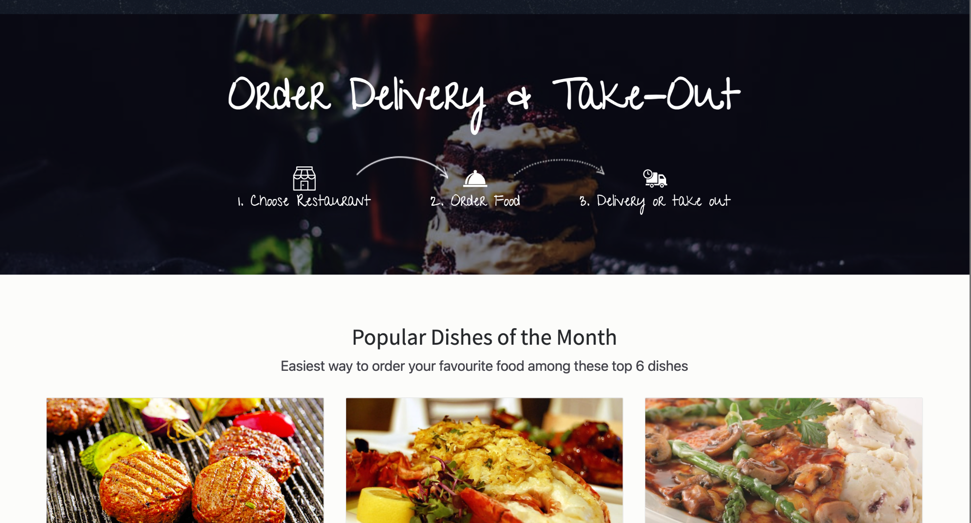
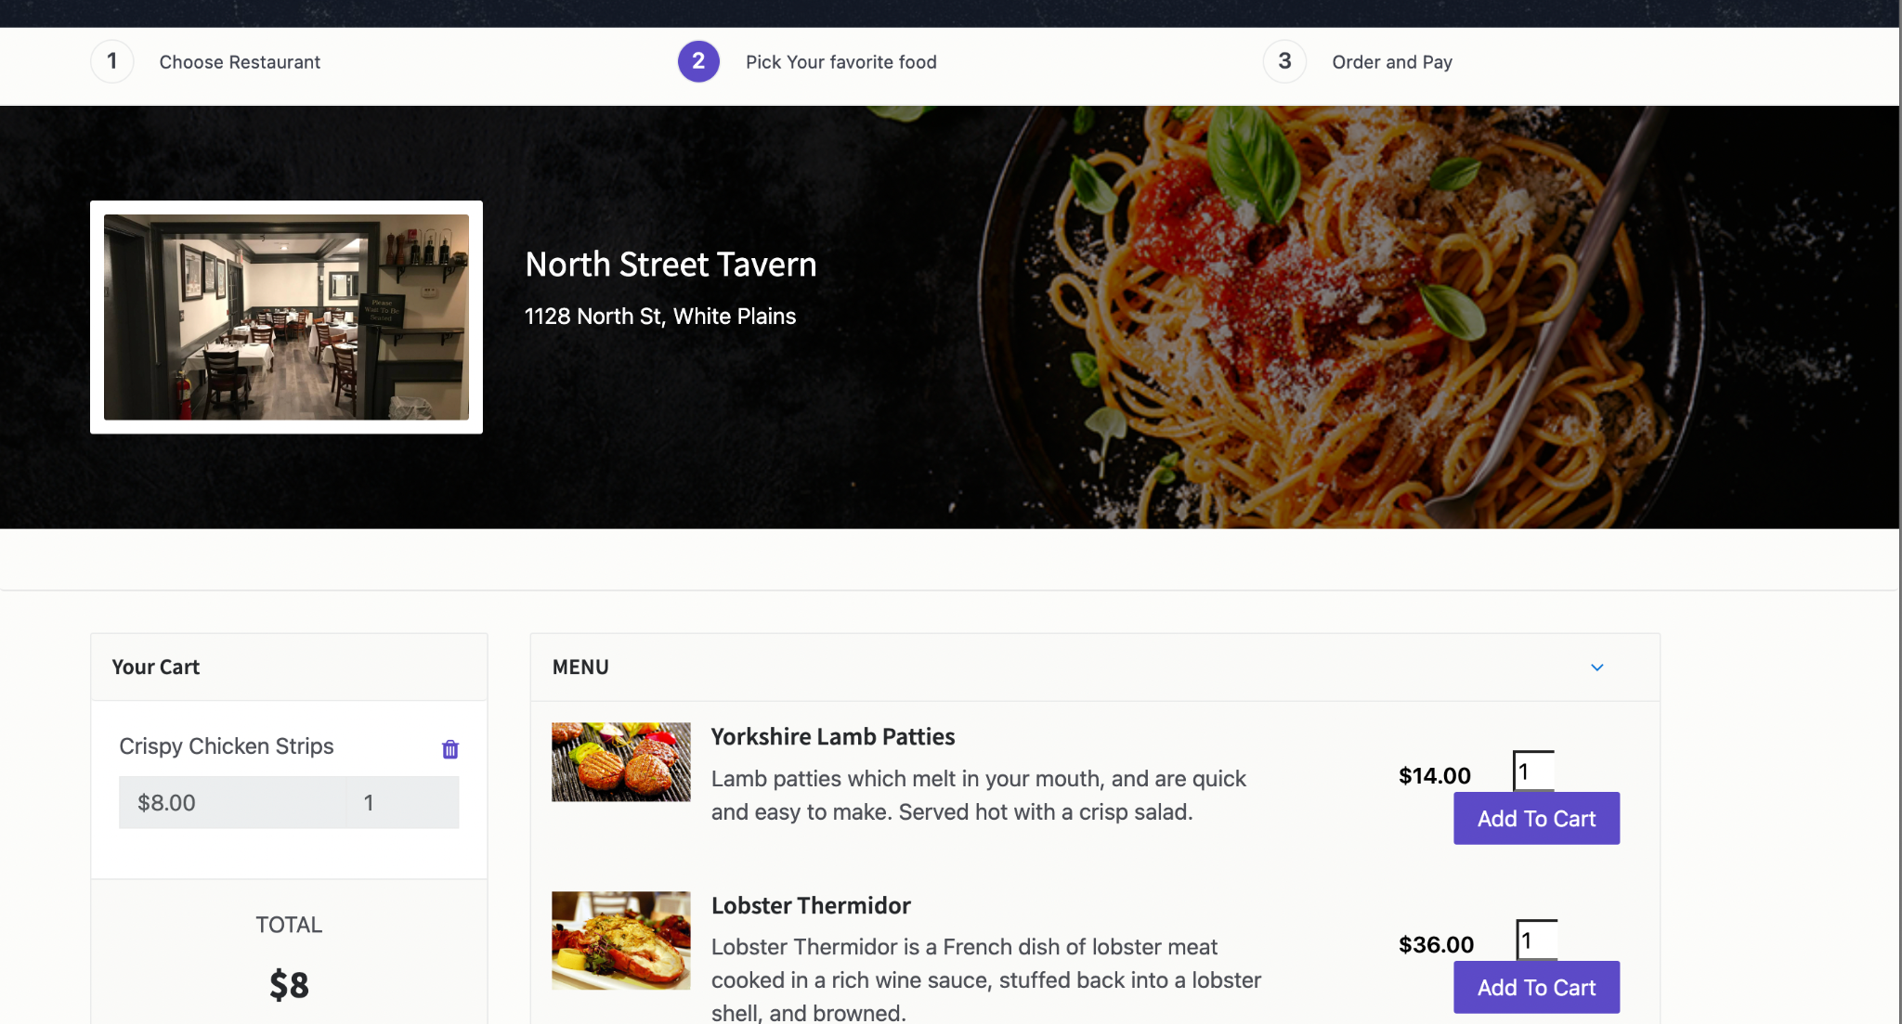
Thank You
It's time to enjoy the finer things in life.

